Slide 1
CS 5402 Introduction to Data Mining
Data Output
v.1.0
Perry B. Koob, koobp@mst.edu

Slide 2
What we are going to learn…
Types of outputs of Data Mining
Visualizations

Slide 3
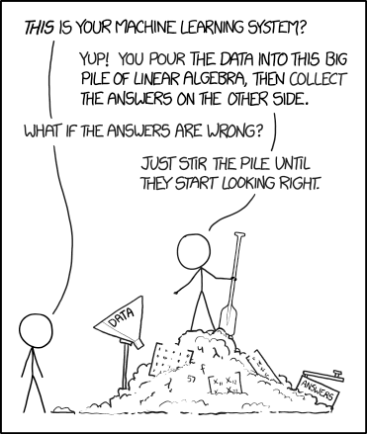
https://xkcd.com/1838/

Slide 4
What kinds of output can we expect?
Tables
Linear Models
Trees
Rules
Instance-Based Representation
Clusters
Visualizations

Slide 5
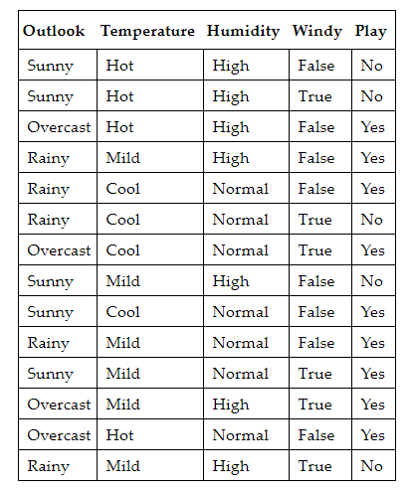
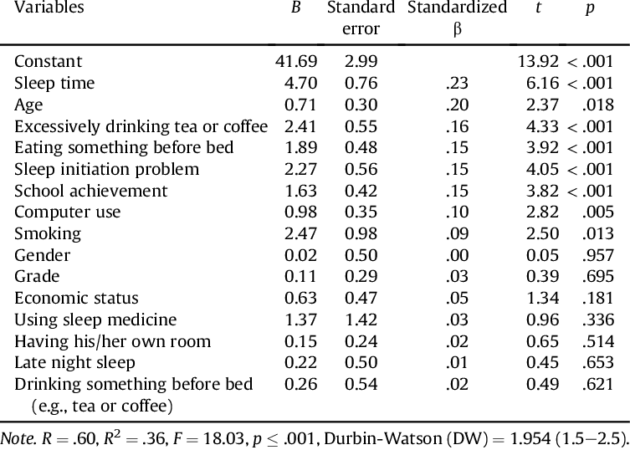
Tables
Output of Classification
Output of Multiple Regression
(Bektas et al, 2016)

Slide 6
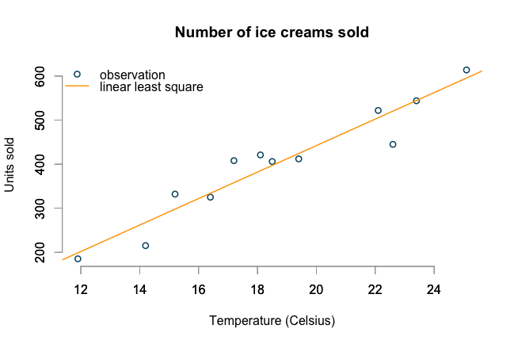
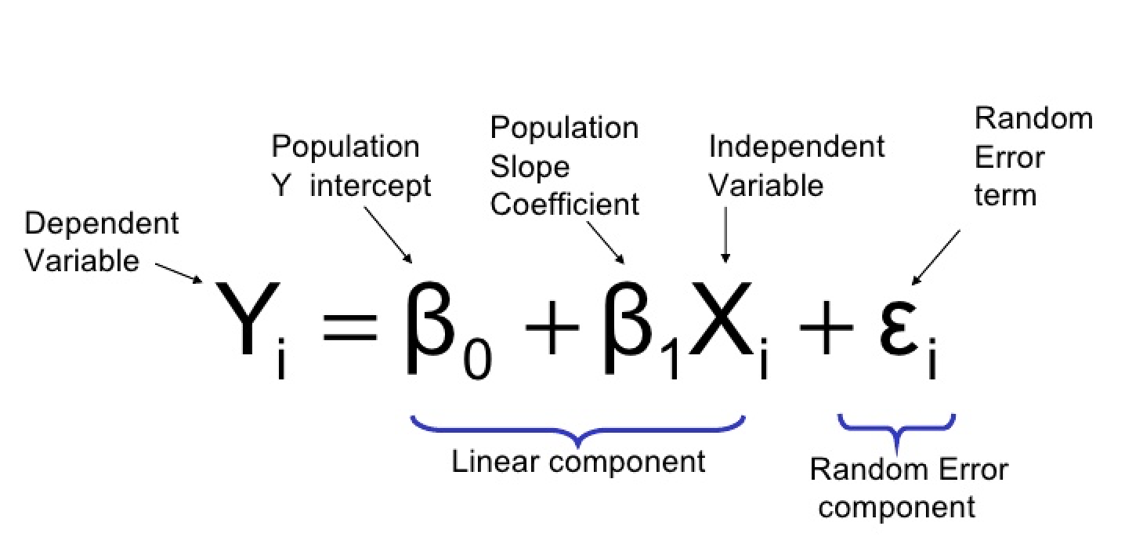
Linear Models
Output of Simple Linear Regression.
https://www.r-bloggers.com/generalised-linear-models-in-r/
https://towardsdatascience.com/how-are-logistic-regression-ordinary-least-squares-regression-related-1deab32d79f5

Slide 7
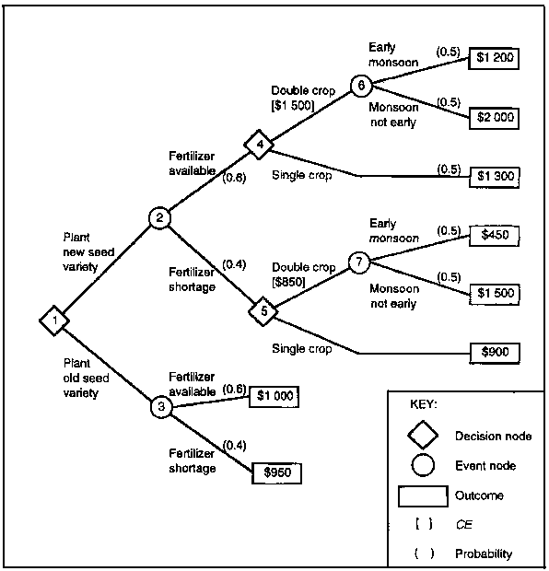
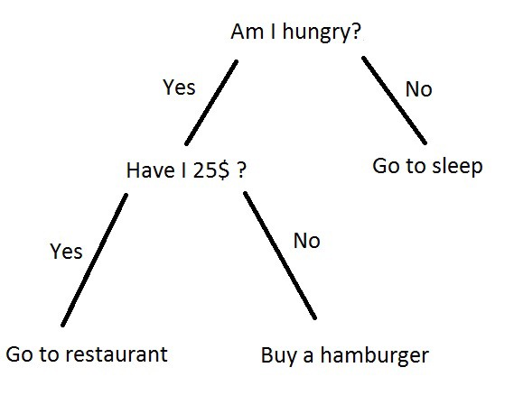
Trees
Decision Tree with probabilities.
Decision Tree
http://www.fao.org/3/w7365e0e.htm
https://becominghuman.ai/understanding-decision-trees-43032111380f

Slide 8
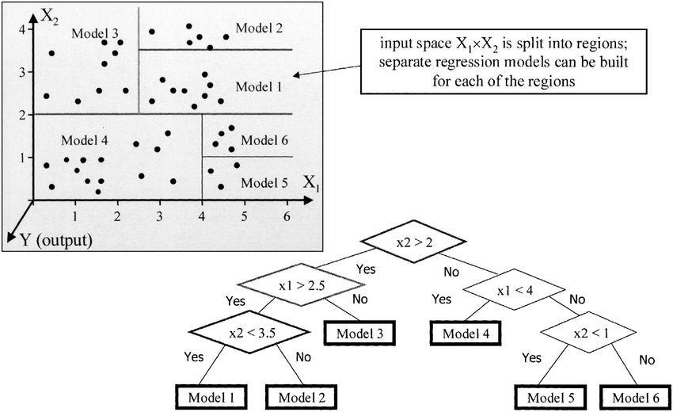
Trees
Regression
Tree
(Solomatine & Xue, 2004)

Slide 9
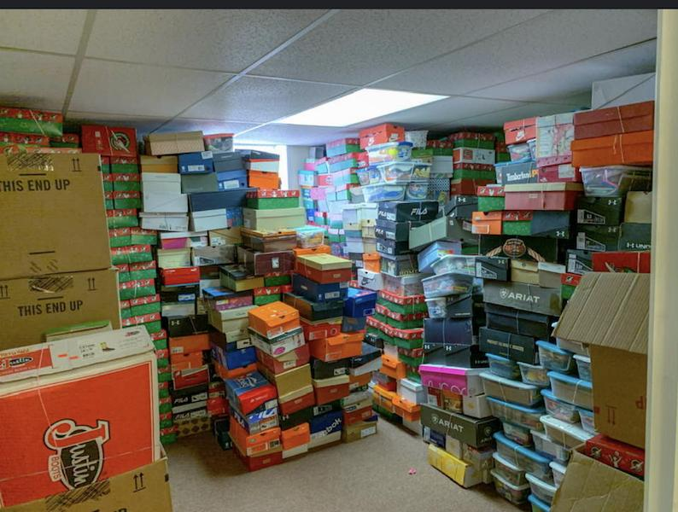
Trees
Regression
Tree
https://www.clantonadvertiser.com/2019/10/18/tis-the-season-for-shoeboxes/

Slide 10
Trees
Regression
Tree
https://www.r-bloggers.com/generalised-linear-models-in-r/

Slide 11
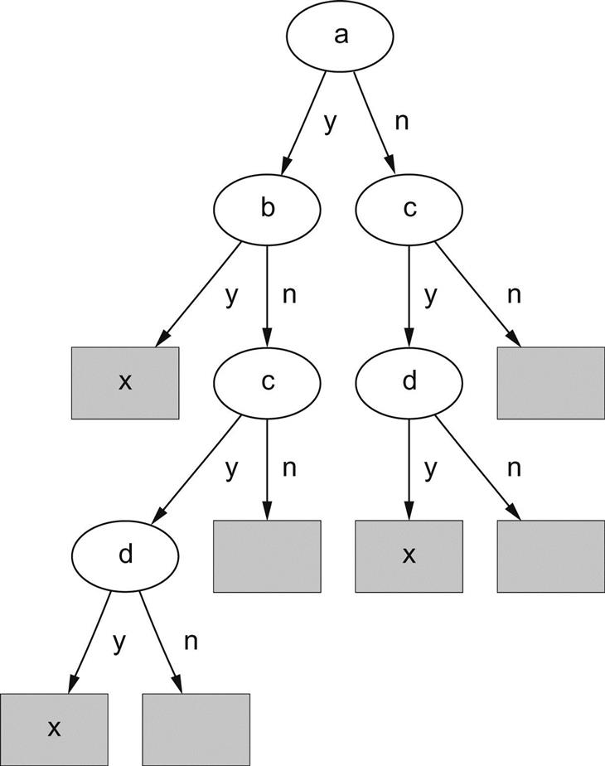
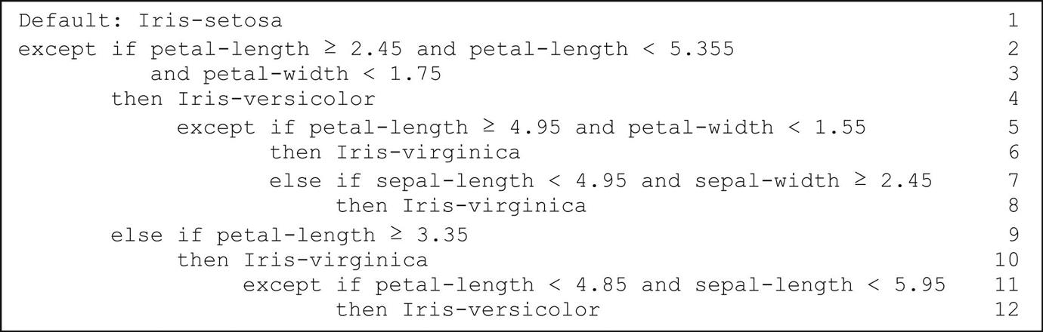
Rules

Slide 12
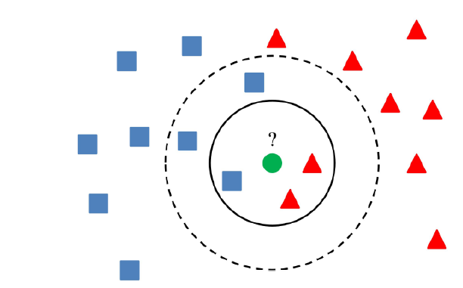
Instance-Based Representation
K Nearest Neighbor
(Alaliyat, 2008)

Slide 13
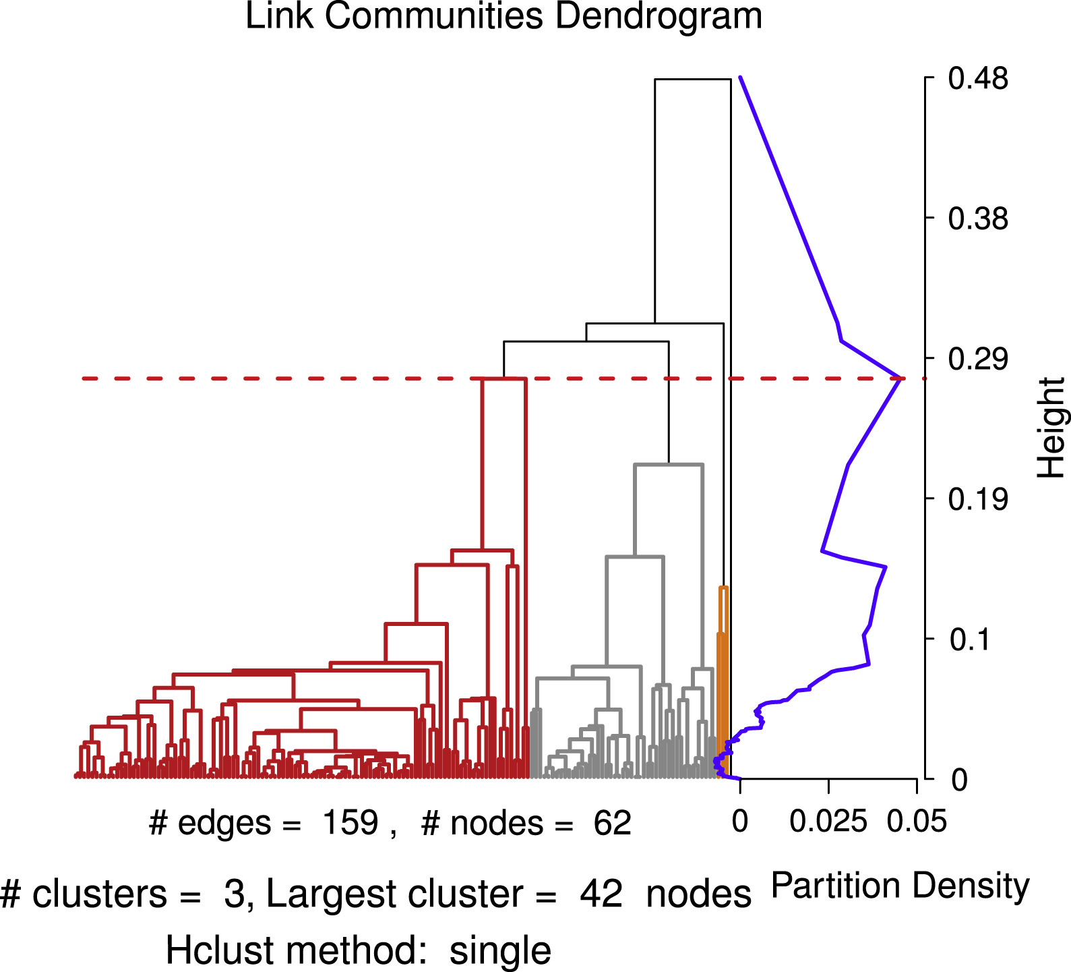
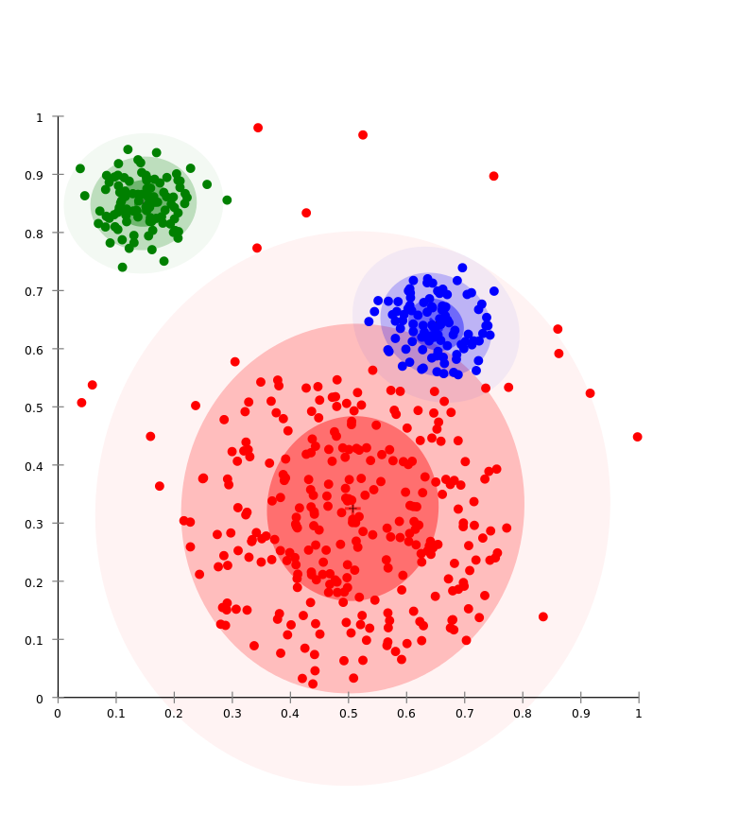
Clusters
Hierarchical Clustering
https://upload.wikimedia.org/wikipedia/commons/d/d8/EM-Gaussian-data.svg
(Gui, Zhang, Hu, Huang, & Wei, 2018)

Slide 14
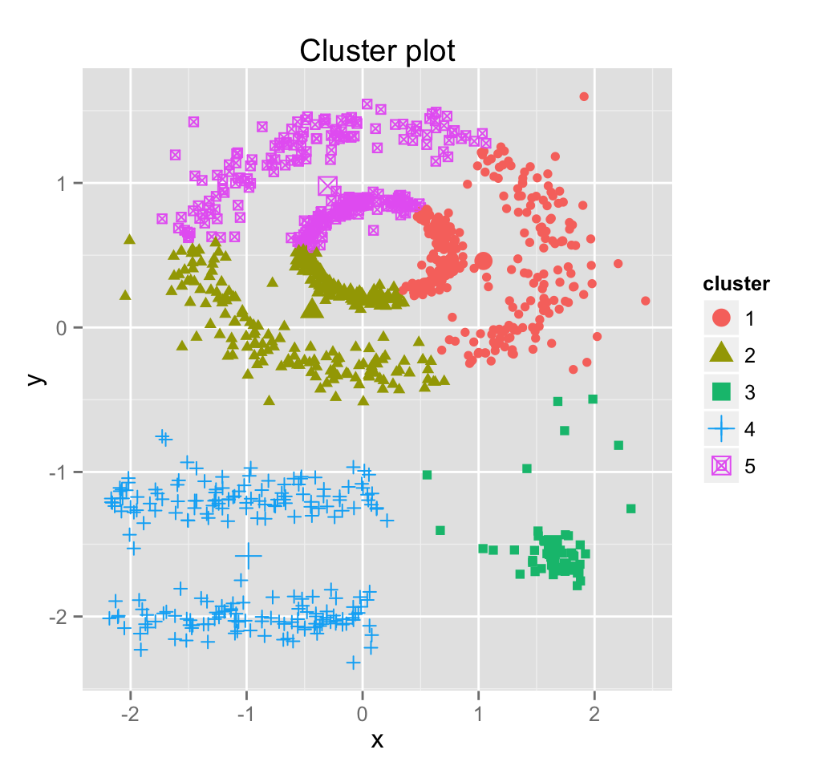
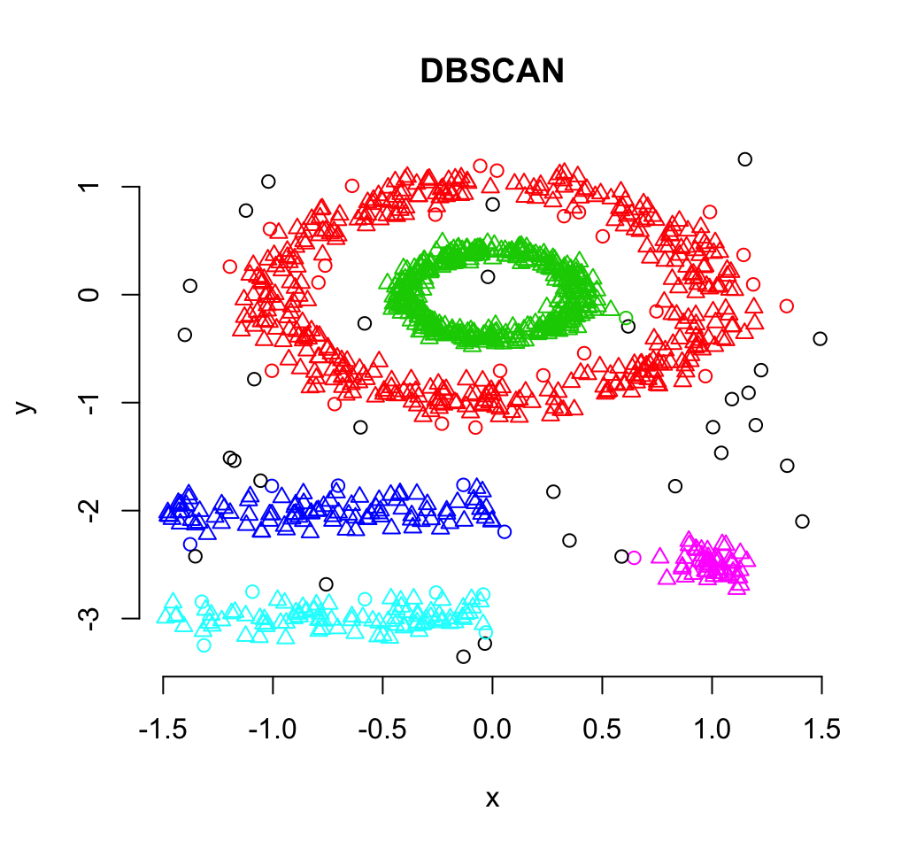
Clusters
http://www.sthda.com/english/wiki/wiki.php?id_contents=7940

Slide 15
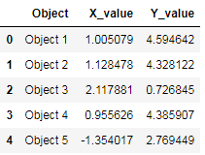
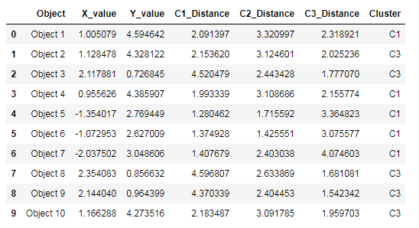
What is really going on...
Data
Data
Cluster Labels
https://blog.floydhub.com/introduction-to-k-means-clustering-in-python-with-scikit-learn/

Slide 16
What is really going on...
Data
List of Cluster Members Indexes
[0, 3, 4, 5, 6,]
[]
[1, 2, 7, 8, 9,]
https://blog.floydhub.com/introduction-to-k-means-clustering-in-python-with-scikit-learn/

Slide 17
What is really going on...
Data
List of Cluster Members
[Object 1, Object 4, Object 5, Object 6, Object 7]
[]
[Object 2, Object 3, Object 8, Object 9, Object 10]
https://blog.floydhub.com/introduction-to-k-means-clustering-in-python-with-scikit-learn/

Slide 18
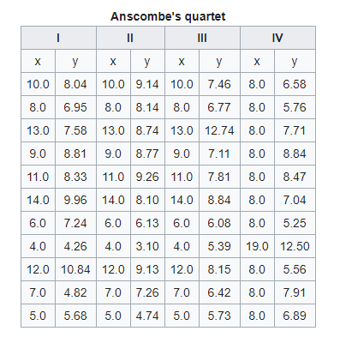
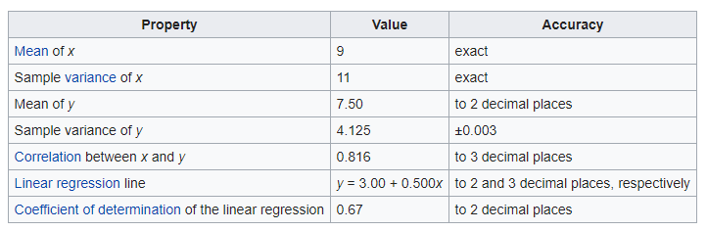
Visualizations - Anscombe Quartet
https://en.wikipedia.org/wiki/Anscombe%27s_quartet

Slide 19
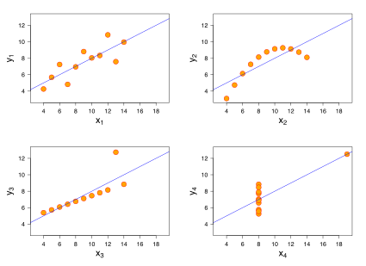
Visualizations - Anscombe Quartet
https://en.wikipedia.org/wiki/Anscombe%27s_quartet

Slide 20
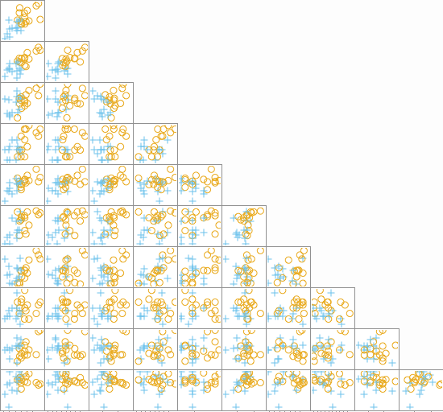
Visualizations - Multi-dimensional
https://stats.stackexchange.com/questions/52625/visually-plotting-multi-dimensional-cluster-data

Slide 21
Visualizations - Avoid Chart Junk
Chart Junk is any extra features that confuse the decoding of the information by the reader.
3D features
Irregular Shapes
Changing in multiple dimensions
https://infovis-wiki.net/wiki/Chart_Junk

Slide 22
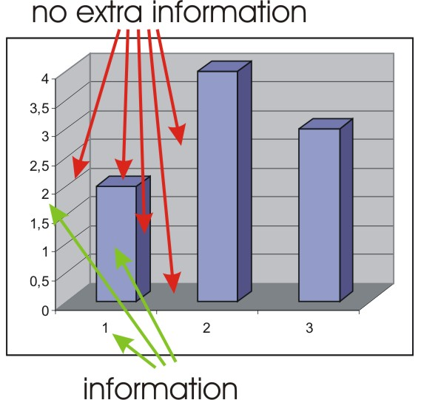
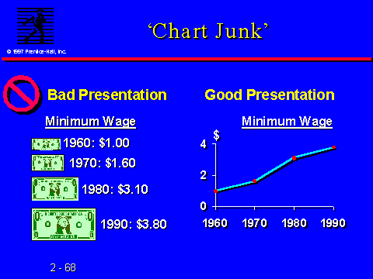
Visualizations - Avoid Chart Junk
https://infovis-wiki.net/wiki/Chart_Junk

Slide 23
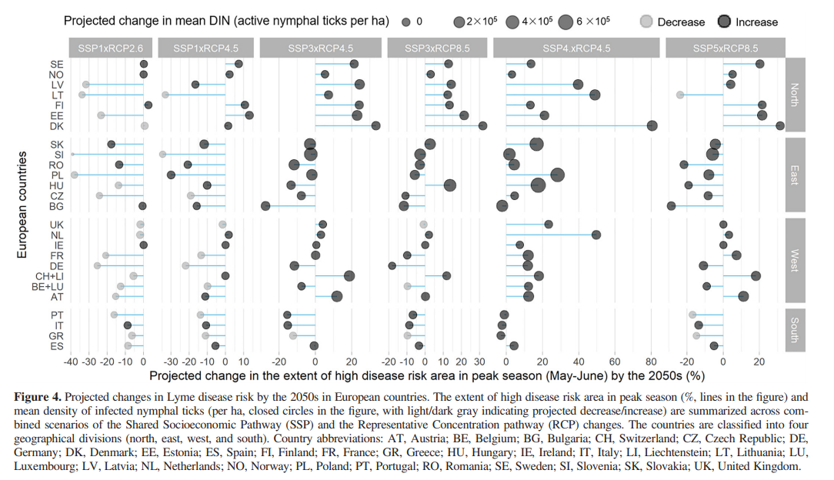
Visualizations - Avoid Chart Junk
Li, S., Gilbert, L., Vanwambeke, S. O., Yu, J., Purse, B. V., & Harrison, P. A. (2019). Lyme disease risks in Europe under multiple uncertain drivers of change. Environmental health perspectives, 127(6), 067010.

Slide 24
What we learned about…
Types of outputs of Data Mining
Visualizations

Slide 25
References
Alaliyat, S. (2008). Video-based fall detection in elderly’s houses (Master's thesis).
Bektas, M., Bektas, I., Ayar, D., Selekoglu, Y., Ayar, U., Kudubes, A. A., ... & Armstrong, M. (2016). Psychometric properties of Turkish version of pediatric daytime sleepiness scale (PDSS-T). Asian nursing research, 10(1), 62-67.
Gui, C., Zhang, R., Hu, R., Huang, G., & Wei, J. (2018). Overlapping communities detection based on spectral analysis of line graphs. Physica A: Statistical Mechanics and Its Applications, 498, 50-65.

Slide 26
References
Solomatine, D. P., & Xue, Y. (2004). M5 model trees and neural networks: application to flood forecasting in the upper reach of the Huai River in China. Journal of Hydrologic Engineering, 9(6), 491-501.
Witten, I. H., Frank, E., Hall, M. A., & Pal, C. J. (2016). Data Mining: Practical Machine Learning Tools and Techniques.

